Slide 1
ACM Training
Computational Geometry

Slide 2
Basics
Coordinates & Vector
Revision on Line Operations
Calculating Distances
Finding Point Position
Finding Vector Direction
Line Intersection
Area of Triangle
Exercises

Slide 3
Coordinates & Vector (1)
2D/3D Point Coordinates
  e.g.
  2 Structures are Logically Equivalent
  Sharing Matrix Operations
float Point3D_A[3];
Point3D_A[0] = 12.3f;
Point3D_A[1] = .23f;
Point3D_A[2] = -20.00f;
Y
struct {
float x, y, z;
} Point3D_B;
Point3D_B.x = 32.f;
Point3D_B.y = -1.2e4;
Point3D_B.z = 0.23f;
Z
X

Slide 4
Coordinates & Vector (2)
Vector
  Same data structure as the point
  Relative to the previous coordinates
  Two Vectors are equal regardless of their initial point
(3 , 4)
[1 , 2]
[1 , 3]
[1 , 2]
[2 , -2]
(0 , 0)

Slide 5
Coordinates & Vector (3)
Vector Rules (A, B, C are vector & m, n are scalars)
  Commutative:
    A + B = B + A
  Associative:
    A + (B + C) = (A + B) + C
    (m * n) * A = m * (n * A)
  Additive inverses:
    A + (-A) = 0
  Scalar distribution over Vector addition:
    m * (A + B) = m A + m B
  Vector distribution over Scalar addition:
    (m + n) * A = m * A + n * A
  Others
    A + 0 = A
    A * 1 = A

Slide 6
Line Representation
Point Slope Form:
  y = m * x + c
  m = Slope = Δy/Δx
  c = y-intercept
General Form
  a * x + b * y + c = 0
Two-Point Form
  (y - y_{B}) / (x - x_{B}) = (y_{B} - y_{A}) / (x_{B} - x_{A})
All 3 forms are referring to an infinite line but not a line segment
y
m=Δy/Δx
c
O
x
y
m= -a/b
-c/b
-c/a
O
x
B
m=Δy/Δx
Δy = y_{B}-y_{A}
A
Δx = x_{B}-x_{A}

Slide 7
Three points on the same line
Collinear Points/Lines
  Given 3 points A, B, C
  Ensure (x_{C} - x_{B}) <> 0 and (x_{B} - x_{A}) <> 0
  Slopes are the same for line (A, B) and (B, C)
    (y_{C} - y_{B}) / (x_{C} - x_{B}) = (y_{B} - y_{A}) / (x_{B} - x_{A})
  Another form
    (y_{C} - y_{B}) * (x_{B} - x_{A}) = (y_{B} - y_{A}) * (x_{C} - x_{B})
  Which one is better?
C
B
A

Slide 8
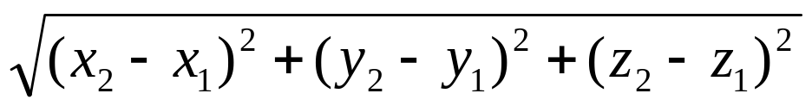
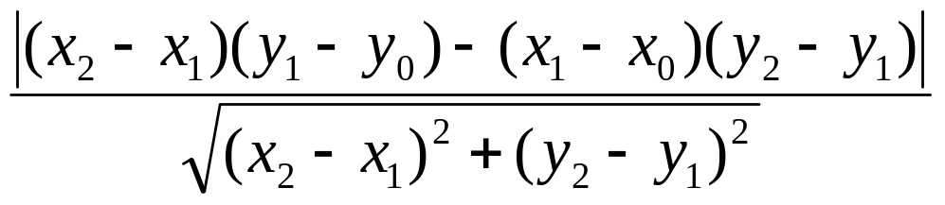
Calculating Distances
Point-Point Distance - 2D
Point-Point Distance - 3D
Point-Line Distance - 2D
(x₁, y₁)
(x₂, y₂)
u=(x₂-x₁, y₂-y₁)
(x₀, y₀)

Slide 9
Dot Product
Dot product: A way to test similar directions
Dot product is zero when vectors are perpendicular
a
b
a
b

Slide 10
Point-Line Distance - 2D
(x₁, y₁)
u is the vector from P₂ to P₁
  u = (x₂-x₁, y₂-y₁)
v is the vector perpendicular to u
  v = ( -(y₂-y₁), x₂-x₁) Note:
r is the vector from P₀ to P₁
  r = (x₁-x₀, y₁-y₀)
distance d is the projection of r into the direction of v
(x₂, y₂)
v
d
u
r
(x₀, y₀)

Slide 11
Finding Point Position
Which Side of the Line
  Given a point P=(x₀,y₀) and substitute into
    a * x + b * y + c = 0
    S= a * x₀ + b * y₀ + c
  3 possible results of S
    Equal to Zero: On the line
    Same sign as c: Same side as (0, 0)
    Different sign as c: Different side as (0, 0)
sign (S) = sign (c)
a * x + b * y + c = 0
Origin (0, 0)
= 0
sign (S) <> sign (c)

Slide 12
Line Intersection
A
A
D
C
B
D
C
B
Methods
  line representation of AB and CD
    Point slope form? No
    Two point form? No
    General form?
  Calculate the common solution
    Yes – intersect
    No – parallel
  If you get the unique intersection point of two lines
    Test whether it is in the range of two segments
    Float point division error make this not accurate

Slide 13
Line Intersection
2 Ends of the 2nd Line should be in different sides respect to the 1st Line
Vice Versa
Why need to test twice?
P₃
P₃
P₂
P₂
P₄
P₄
P₁
P₁

Slide 14
Line Intersection (improvement)
2 Ends of the 2nd Line should be in different sides respect to the 1st Line
Vice Versa
Look at direction of vector turns.
P₃, P₄, P₂
is Anti-Clockwise
P₃
P₃
P₂
P₂
P₁, P₂, P₃
is Anti-Clockwise
P₄
P₄
P₁, P₂, P₄
is Clockwise
P₁
P₁
P₃, P₄, P₁
is Clockwise

Slide 15
Finding Vector Direction
In 2D Coordinate System, judging which side the vector turns
  Given 3 points
  We cannot determine the direction simply by their slopes
Clockwise
P₂
P₁
P₃
P₃
Anti-clockwise
P₁
P₂

Slide 16
Finding Vector Direction
Determining Direction (Case 1)
  When (x₃ - x₂) and (x₂ - x₁) are the same sign
  It is Anti-Clockwise, if and only if
  (y₂ - y₁) / (x₂ - x₁) < (y₃ - y₂) / (x₃ - x₂)
P₃ (x₃, y₃)
P₁ (x₁, y₁)
P₂ (x₂, y₂)
P₂ (x₂, y₂)
Two cases:
(x₂ - x₁) * (x₃ - x₂) > 0
<Positive>
P₃ (x₃, y₃)
P₁ (x₁, y₁)

Slide 17
Finding Vector Direction
Determining Direction (Case 2)
  When (x₃ - x₂) and (x₂ - x₁) are different signs
  It is Anti-Clockwise, if and only if
  (y₂ - y₁) / (x₂ - x₁) > (y₃ - y₂) / (x₃ - x₂)
P₃ (x₃, y₃)
P₃ (x₃, y₃)
P₂ (x₂, y₂)
Two cases:
(x₂ - x₁) * (x₃ - x₂) < 0
<Negative>
P₂ (x₂, y₂)
P₁ (x₁, y₁)
P₁ (x₁, y₁)

Slide 18
Finding Vector Direction
Determining Anti-Clockwise (Case 1)
  (y₂ - y₁) / (x₂ - x₁) < (y₃ - y₂) / (x₃ - x₂)
  Multiply 2 sides with (x₂ - x₁) * (x₃ - x₂) > 0
  Then, (x₃ - x₂)(y₂ - y₁) < (y₃ - y₂)(x₂ - x₁)
Determining Anti-Clockwise (Case 2)
  (y₂ - y₁) / (x₂ - x₁) > (y₃ - y₂) / (x₃ - x₂)
  Multiply 2 sides with (x₂ - x₁) * (x₃ - x₂) < 0
  Then, (x₃ - x₂)(y₂ - y₁) < (y₃ - y₂)(x₂ - x₁)
Determining Anti-Clockwise (Both Cases)
  (y₃ - y₂)(x₂ - x₁) - (x₃ - x₂)(y₂ - y₁) > 0
  (x₁y₂ - x₂y₁) + (x₂y₃ - x₃y₂) + (x₃y₁ - x₁y₃) > 0

Slide 19
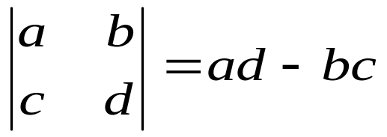
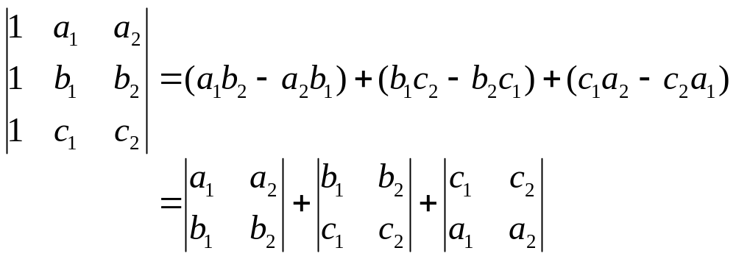
Finding Vector Direction
General Form of Determinant
Simplified Form of Determinant

Slide 20
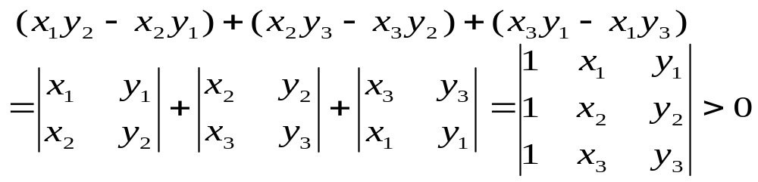
Finding Vector Direction
Determining Anti-Clockwise (Generalize)
Determining Directions (Generalize)
If > 0, then Anti-Clockwise
If < 0, then Clockwise
If = 0, then Collinear

Slide 21
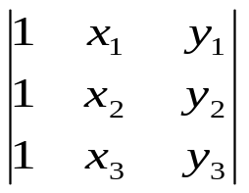
Line Intersection
Let cw (P₁, P₂, P₃) =
Given 2 Lines (P₁, P₂) and (P₃, P₄)
They are intersected, if and only if
  cw (P₁, P₂, P₃) * cw (P₁, P₂, P₄) < 0
  cw (P₃, P₄, P₁) * cw (P₃, P₄, P₂) < 0
Be careful on those marginal cases!
P₃
P₃
P₂
P₂
P₁, P₂, P₃
is Anti-Clockwise
P₃, P₄, P₂
is Anti-Clockwise
P₄
_{P4}
P₁, P₂, P₄
is Clockwise
P₁
P₁
P₃, P₄, P₁
is Clockwise

Slide 22
Vector Direction - Another Explanation
If we consider two vectors instead of three points
  (y₃ - y₂)(x₂ - x₁) - (x₃ - x₂)(y₂ - y₁) > 0
  x_{b}=x₃-x₂; y_{b}=y₃-y₂; x_{a}=x₂-x₁; y_{a}=y₂-y₁
  y_{b}x_{a} - x_{b}y_{a} > 0
This is called the "cross product of two vectors"
P₃
Anti-clockwise
b
P₁
a
P₂

Slide 23
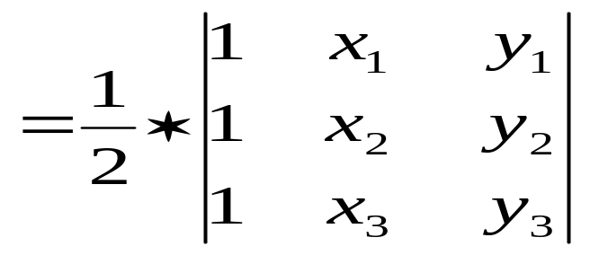
Area of Triangle
Given 3 Points
Also, notice those marginal cases
  Determinant is negative (points are clockwise)
  3 points are collinear
  In C/C++, testing a float number is Zero may not always get the expected result
    You may define a constant called Epsilon = 0.0001, which specified the floating point accuracy
    If the absolute value of a float number N is less than or equal to the Epsilon, it is considered as zero
P₃
Area
P₂
P₁

Slide 24
Line Intersection
How to find out boundary cases?

Slide 25
Exercises
#184 - Laser Lines (Try this first)
  http://online-judge.uva.es/p/v1/184.html
#191 - Intersection
  http://online-judge.uva.es/p/v1/191.html
#248 - Cutting Corners (Challenging)
  http://online-judge.uva.es/p/v2/248.html
#460 - Overlapping Rectangles
  http://online-judge.uva.es/p/v4/460.html
#866 - Intersecting line segments (So Easy)
  http://online-judge.uva.es/p/v8/866.html

Slide 26
Polygons
Revision on Intersection
Area of Polygons
Convex Polygon and Non-Convex Polygon
Point Inside Polygon
Exercises
References

Slide 27
Revision on Intersection
Basic Knowledge
  Distinguish between a Line and a Line Segment
  Which side is a Point located according to a Directed Line (Vector)
    Anti-clockwise & Clockwise
  The general case can be illustrated by the determinant
  The determinant is the area of the triangle times 2
    area (a, b, c) * 2 = determinant (a, b, c)

Slide 28
Revision on Intersection (2)
2 times of the triangle area
Point Positions
int areaX2(Point2D &a, Point2D &b, Point2D &c)
{
return ((b.x – a.x) * (c.y – a.y) –
(c.x – a.x) * (b.y – a.y));
}
c
Left
b
c
a
On
int leftSide(Point2D &a, Point2D &b, Point2D &c)
{ return (areaX2(a, b, c) > 0); }
int leftSideOn(Point2D &a, Point2D &b, Point2D &c)
{ return (areaX2(a, b, c) >= 0); }
int collinear(Point2D &a, Point2D &b, Point2D &c)
{ return (areaX2(a, b, c) == 0); }

Slide 29
Revision on Intersection
Point C Between Point A & B
bool between(Point2D &a, Point2D &b, Point2D &c)
{
Point2D ba, ca;
if (!collinear(a,b,c)) return false;
if (a.x != b.x) // Line A-B is not Vertical
return (((a.x <= c.x) && (c.x <= b.x)) ||
((a.x >= c.x) && (c.x >= b.x)));
else
return (((a.y <= c.y) && (c.y <= b.y)) ||
((a.y >= c.y) && (c.y >= b.y)));
}
Not In Between
In Between

Slide 30
Polygon Triangulation
Given a 2D Polygon
  A set of directed points/vectors
  Simple Polygon
    Boundary not intersect itself anywhere
    Can be Convex or Concave
  Not Multiple-Connected
  Divide the Simple Polygon into triangles
  No need to introduce new point
Multiple-
Connected
Simple
Complex

Slide 31
Triangulation of Convex Polygon
P₆
P₁
A(P₁,P₂,P₃)
P₅
P₂
P₄
P₃
Note: P_{N+1} = P₁

Slide 32
Partition of General Polygons
Directed Area
  Right hand order (clockwise): negative
  Left hand order (anti-clockwise): positive
P₄
P₃
P₂
P₆
P₅
P₁

Slide 33
A Direct Way to get the formula
Use an arbitrary point to partition the polygon into N triangles
Use the origin!
O

Slide 34
Point Inside Polygon
Given a Simple Polygon & a Point
  The point will be either
    Inside the polygon (Strictly Interior)
    Outside the polygon (Strictly Exterior)
    On the edge (but not an Endpoint)
    Same as the polygon vertex/point
  Winding Number Algorithm
    Simple to implement
    Hard to detect on Edge and Vertex cases
  Ray Crossings Algorithm
    Complicated
    More Precise to identify all 4 cases

Slide 35
Point Inside Polygon
Winding Number Algorithm
  Calculate all the Angular Turn of 2 consecutive edge points
  Sum all the angles of the turns
    0º : Outside
    360º : Inside
Angular Turn

Slide 36
Point Inside Polygon
Ray Crossings Algorithm
  Using a reference point
    Far enough to be outside the polygon
    Form a Horizontal Line with Testing Point
  Count the number of Intersections for the Horizontal Line and All Edges
    Odd : Inside
    Even : Outside
  Source Code
  http://maven.smith.edu/~orourke/books/compgeom.html
Inside
Reference
Points
Outside
Vertex
Edge

Slide 37
Exercises
#137 - Polygons
  http://online-judge.uva.es/p/v1/137.html
#132 - Bumpy Objects
  http://online-judge.uva.es/p/v1/132.html
#588 - Video Surveillance
  http://online-judge.uva.es/p/v5/588.html
#881 - Points, Polygons & Containers
  http://online-judge.uva.es/p/v8/881.html
#10321 - Polygon Intersection
  http://online-judge.uva.es/p/v103/10321.html
#634 - Polygon
  http://online-judge.uva.es/p/v6/634.html
ACM ICPC 2002 World Final
  Problem F, Toil for Oil
  http://icpc.baylor.edu/past/icpc2002/Finals/problems.pdf

Slide 38
Convex Hull
What is Convex Hull?
Finding the Extremes
Gift Wrapping Algorithm
More Convex Hull Property
Quick Hull Algorithm
Merge Hull Algorithm
Graham Scan
Exercises
References

Slide 39
What is Convex Hull?
Given a finite number of points as S
The smallest convex set containing S
2-D Convex Hull
  All points are on a plane
  Like using a stretched
  rubber band to
  surround all the points

Slide 40
What is Convex Hull?
What are the Extremes?
  Extreme Point:
    Point on the Convex Hull Polygon
  Extreme Edge:
    Line Segment on the Convex Hull Polygon
Possible Solutions
  All Extreme Points in boundary traversal order
  All Extreme Edges in boundary traversal order

Slide 41
Gift Wrapping Algorithm
Start from one of the Extreme Point on the Convex Hull Polygon
  Usually the Rightmost-Lowest point
  Which is guaranteed to be an Extreme Point
Extend the Extreme Point to a Vertical Line as the starting edge E
All the other points are on the left side of this starting edge E
Edge E
Starting
Point (B)
Imaginary Reference Point (A)

Slide 42
Gift Wrapping Algorithm
The point with the smallest left turning angle with respect to edge E is the next Extreme Point
Turning Angles are important
First Iteration
Extreme
Point (N)
Smallest Angle
Edge E
Starting
Point (B)
Imaginary Reference Point (A)

Slide 43
Gift Wrapping Algorithm
Form new Edge E from previous two extreme points.
Find next extreme point
Iterate…
Second Iteration
Smallest Angle
Extreme
Point (N)
Starting
Point (B)
Edge E
Reference
Point (A)

Slide 44
Gift Wrapping Algorithm
Complexity is O(N*H), where H is the number of Extreme Edges on the Convex Hull Polygon
Worst case is that all points are lying on a circle, where H = N
Third Iteration
Starting Point (B)
Smallest Angle
Edge E
Extreme
Point (N)
Reference
Point (A)

Slide 45
Gift Wrapping Algorithm
First Iteration
Second Iteration
Extreme
Point (N)
Extreme
Point (N)
With the
Smallest Angle
Starting
Point (B)
Starting
Point (B)
Reference
Point (A)
Imaginary Reference Point (A)

Slide 46
Gift Wrapping Algorithm
OrderedPtSet GiftWrap (PointSet S) {
OrderedPtSet H = EMPTY;
Point B = RightmostLowest(S); // Starting Point
Point A = Point(B.x, 0); // Reference Point
Point P, N;
float minAngle = 180.0f, curAngle;
do {
for (P=S.begin(); P<=S.end(); P++) {
curAngle = Angle(A, B, P);// Left-Turn Angle
if (minAngle > curAngle) {
minAngle = curAngle; // Largest Angle
N = P; // Rightmost Point
}
}
H.append(B); // Append the Extreme Point
A = B; // Shift the Reference Point
B = N; // Shift the Starting Point
} while (B != H[0]);
return H;
}
Gift Wrapping (Web Sample)

Slide 47
More Convex Hull Property
  For each edge (Extreme Edge) of the convex hull polygon, all points lying on one side only
  Both the Leftmost and Rightmost points are definitely in the Convex Hull Polygon
  Connecting these 2 points will separate the points into 2 subsets
Upper-Hull
Lower-Hull

Slide 48
More Convex Hull Property
  Union the Convex Hulls of the points in Upper-Hull and points in Lower-Hull will construct the full-size Convex Hull
  Respect to the separating line, the farthest points are the Extreme Points
Upper-Hull
Lower-Hull

Slide 49
Quick Hull Algorithm
Initially separate the point set into the Upper Hull and the Lower Hull
Find the farthest point H with respect to Line LR
H
R
L

Slide 50
Quick Hull Algorithm
Construct 2 lines
  L1, directed from L to H
  L2, directed from H to R
Test where points are lying with respect to both L1 and L2: 3 possibilities…
H
R
L2
L
L1

Slide 51
Quick Hull Algorithm
Points on Right side of both L1 and L2 (LH_{R} and HR_{R})
  not on the Convex Hull Polygon.
Points on Left side of L1 (LH_{L})
  Find the farthest point with respect to L1
  Recursively perform the test
Points on Left side of L2 (HR_{L}) – same procedure as (2)
H
Set (HR_{L})
Set (LH_{L})
R
Set (LH_{R} ∩ HR_{R})
L2
L
L1

Slide 52
Quick Hull Algorithm
Testing which sides do the points lying on with respect to both L1 and L2
  Separated to 3 set of points
  Those points lying on the Right side of both the L1 and L2 are definitely not on the Convex Hull Polygon
Deal with those points in set LH_{R}
  Find the farthest point with respect to L1
  Recursively perform the test
Similar in set HR_{L} but with L2

Slide 53
Quick Hull Algorithm
Close analogy to the Quick-Sort
  Find a Pivot to partition the elements into Left set and Right set
Difference: all points in set LH_{R}HR_{R} are eliminated in each level of the recursion
Due to the elimination, it generally run at O (N log N) like the Quick-Sort
Suffer the same disability as the Quick-Sort with O (N²) in the worst-case

Slide 54
Quick Hull Algorithm
OrderedPtSet QuickHull(Point L, Point R, PointSet S)
{
if (S.empty())
return EMPTY; // No Point means No Hull
Point H; // Farthest Point to Line LR.
float length = 0, distance;
for (Point P=S.begin(); P <= S.end(); P++) {
if (length < (distance = Distance(L, R, P))) {
length = distance; // Farthest Distance
H = P; // Farthest Point
}
}
PointSet A, B; // Upper and Lower Hull Set
for (Point P=S.begin(); P <= S.end(); P++) {
if (Left(L, H, P)) A.insert(P);
else if (Left(H, R, P)) B.insert(P);
}
return QuickHull(L,H,A) | H | QuickHull(H,R,B);
}
Quick Hull (Web Sample)

Slide 55
Quick Hull Algorithm
Pay Attention to
  Handling the Collinear Points on the Convex Hull Polygon
  The order/direction of the output points are essential to construct the Convex Hull Polygon
  What if there are more than 1 Leftmost and Rightmost points?
    If collinear points are included in the Convex Hull, all the Leftmost and Rightmost points are definitely in the Convex Hull Polygon

Slide 56
Merge Hull Algorithm
Divide-and-Conquer Algorithm
  Divide the points in 2 separated sets
  Until there are <= 3 points in a set
    Convex Hull of 3 points is a triangle
  Conquer the solution by merging 2 hulls
Similar to the Merge-Sort which executes in O (N log N)
Able to achieve the O (N log N) even in 3-D environment
Relatively Complicated

Slide 57
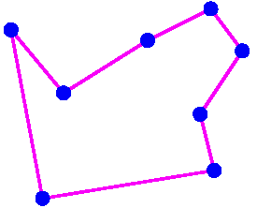
Graham Scan for Convex Hull
Graham Scan algorithm.
  Phase 1: Solve the problem of finding the non-crossing closed path visiting all points

Slide 58
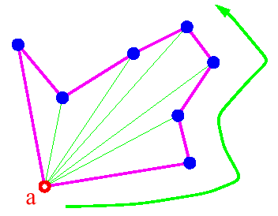
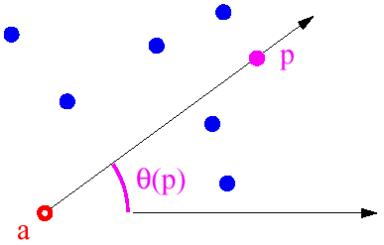
Finding Non-crossing Path
How do we find such a non-crossing path:
  Pick the bottommost point a as the anchor point
  For each point p, compute the angle θ(p) of the segment (a,p) with respect to the x-axis.
  Traversing the points by increasing angle yields a simple closed path

Slide 59
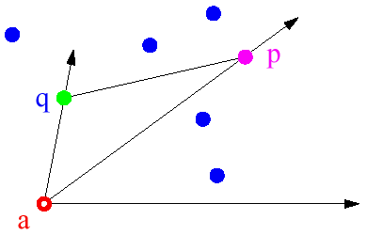
Sorting by Angle
How do we sort by increasing angle?
  Observation: We do not need to compute the actual angle!
  We just need to compare them for sorting
θ(p) < θ(q) ⇔ orientation(a,p,q) is anti-clockwise

Slide 60
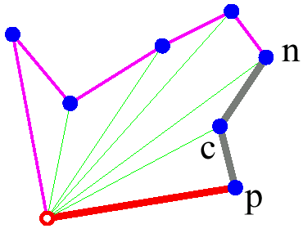
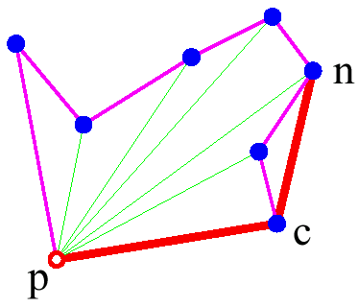
Rotational Sweeping
Phase 2 of Graham Scan: Rotational sweeping
  The anchor point and the first point in the polar-angle order have to be in the hull
  Traverse points in the sorted order:
    Before including the next point n check if the new added segment makes a left turn
    If not, keep discarding the previous point (c) until the left turn is made

Slide 61
Implementation and Analysis
Implementation:
  Stack to store vertices of the convex hull
Analysis:
  Phase 1: O(n log n)
    points are sorted by angle around the anchor
  Phase 2: O(n)
    each point is pushed into the stack once
    each point is removed from the stack at most once
  Total time complexity O(n log n)

Slide 62
Exercises
#596 - The Incredible Hull
  http://online-judge.uva.es/p/v5/596.html
#681 - Convex Hull Finding
  http://online-judge.uva.es/p/v6/681.html

Slide 63
References
Books
  Computational Geometry in C
  by Joseph O'Rourke
  Computational Geometry: An Introduction
  by Franco P. Preparata, Michael Ian Shamos
  Computational Geometry: Algorithms & Applications
  by de Berg, Schwarzkopf, van Kreveld, Overmars
Web
  Geometry: An Introduction (Terms)
  http://math.about.com/library/weekly/aa031503a.htm
  Department of Mathematics (CityU)
  http://personal.cityu.edu.hk/~ma4527/
  MathWorld (Geometry)
  http://mathworld.wolfram.com/topics/Geometry.html
  Mathtools.net (Computational Geometry)
  http://www.mathtools.net/C_C__/Computational_geometry/index.html
  Triangulation (MathWorld)
  http://mathworld.wolfram.com/Triangulation.html
  Mathtools.net (Computational Geometry)
  http://www.mathtools.net/C_C__/Computational_geometry/index.html
  Computational Geometry in C (With Source Code)
  http://maven.smith.edu/~orourke/books/compgeom.html
  Convex Hull Demo (Brute-force & Quick-Hull)
  http://www.piler.com/convexhull/
  Convex Hull 2D/3D Demo (Merge-Hull & Quick Hull)
  http://www.cse.unsw.edu.au/~lambert/java/3d/hull.html
  QHull code for Convex Hull (and other features)
  http://www.qhull.org/

